Slide 1
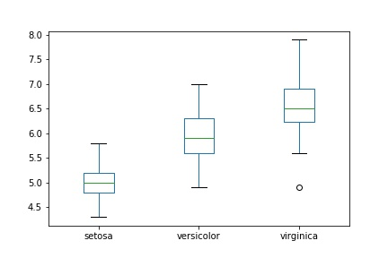
Main purpose is to give a clear indication of the distribution of the dataset.
The most important part of boxplots are the scale, if the scale is chosen incorrectly the boxplot won’t convey any relevant information.

